Slide 1
Re-Envisioning Re-Entry Law Conference
Fines and Fees or Freedom?
Eliminating Re-entry Roadblocks Created by Court Debt and License Suspension

Slide 2
Introductions
Elisa Della-Piana
Legal Director, Lawyers’ Committee for Civil Rights
Avni Desai
Public Policy Manager, Community Housing Partnership
Brittany Stonesifer
Staff Attorney, Legal Services for Prisoners with Children

Slide 3
What court debt might a re-entering person have?
Debts from being convicted and incarcerated
Debts from tickets
Other court debt (like child support)

Slide 4
Court debt from conviction and incarceration
Money Bail:
10% forfeited to bail bondsman
Reform movement, lawsuits going on around the country
Restitution/ conviction costs:
Prosecution and defense fees, court costs
Victim restitution
incarceration costs:
Ankle monitors, drug testing
Debts incurred by families:
Average debt for court fines & fees alone = $13,607 (Who Pays? Report)

Slide 5
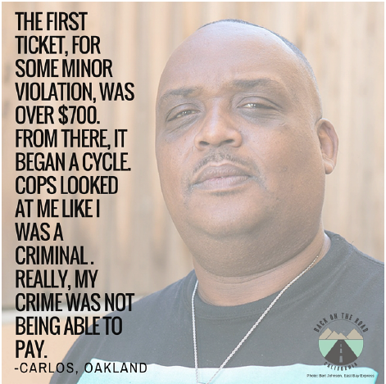
Court debt from tickets = special challenges for re-entering people
Traffic court debt:
Vehicle Code violations
Some moving, some unrelated to driving
Statewide
Municipal debt:
Parking tickets, towing
Quality of Life citations
Local

Slide 6
Traffic Court Debt
Types of tickets:
Moving violations
Non-moving violations
Infractions unrelated to driving
Base fine
Fees and assessments

Slide 7
Consequences for Failures to Pay or Appear:
$300 assessment
License suspension
Bench warrant
Misdemeanor conviction
-Not Just a Ferguson Problem

Slide 8
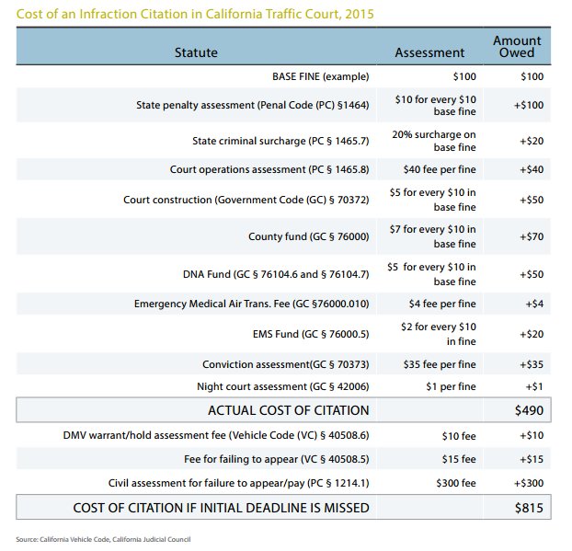
Traffic Court Debt
o Base fine
o Fees and assessments

Slide 9
Temporary Traffic Court Remedy: Amnesty
What is the Amnesty Program?
50% or 80% fee reduction (before 2013)
License reinstatement
Who is eligible?
How can someone apply?
Deadline: March 31, 2016
SB 881: 90 day processing

Slide 10
Other Traffic Court Remedies: It’s Worth a Try
Reinstate Driver’s License
Purging Driving Record – VC 12808(c) gives DMV discretion to “purge” suspensions for FTA/ FTP more than 5 years old
Vehicle Code 41500 – Traffic citation pending when sentenced for California felony
Decrease Overall Debt
Request an Ability to Pay hearing
Motion to dismiss ticket in the interest of justice
Letter to judge for reconsideration

Slide 11
Some relief on the horizon?
Judicial Council Advocacy:
Ability to pay determinations
Meaningful notice
Futures commission:
Alternatives to payment
Decriminalization

Slide 12
Back on the Road California
Who are we?
What do we do?
How can you get involved?

Slide 19
90

Slide 20
Debt Free SF

Slide 23
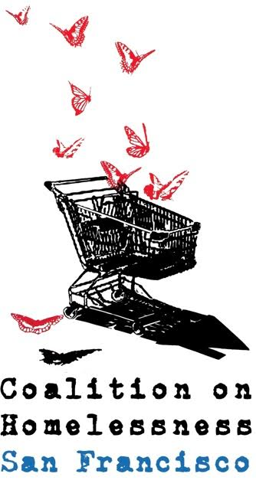
Debt Free San Francisco Contact info: facebook.com/debtfreesf
Notes:
Add one sentence on who we are

Slide 24
Impact on Indigent People
Court Debt is a Ball and Chain

Slide 25
Court-debt
penalizes poverty
“Quality of life” citations
Jay-walking
Littering
Sleeping in public
Failure to pay MUNI fare
Notes:
1. Penalizes people for being low income
-Court debt and license suspension happens for a wide range of reasons, many of which are not related to driving safety, but are actually tied to poverty; QOL citations

Slide 26
Impact on Reentering People
Rent & food… or court-debt?
Reentering people & families more financially vulnerable already
Impact on homeless pop, in particular
License suspension is a barrier to employment, education, family reunification:
NJ Study: 42% lost jobs; 45% could not find another, 88% decreased wages
Probation/ parole conditions require:
Meeting with supervising agent
No new crime (driving w suspended license = misdemeanor)
Notes:
3. Causes unemployment and traps people in cycles of poverty
-Siphons funds from other necessities like rent, food, medical care, transportation, child care
-Having a suspended license limits employment options, ability to get to doctors appointments or take children to school
4. Excessive court debt and license suspension creates pathways to incarceration
-Sometimes these critical necessities leave people with no other option but to drive, subjecting them to arrest for driving on suspended license, a misdo
-Isolating people from the formal economy makes participating in the informal economy necessary to survival
-Makes complying with conditions of probation or parole impossible for some

Slide 27
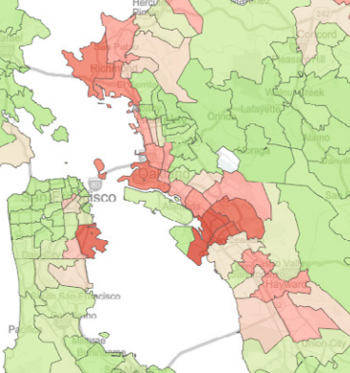
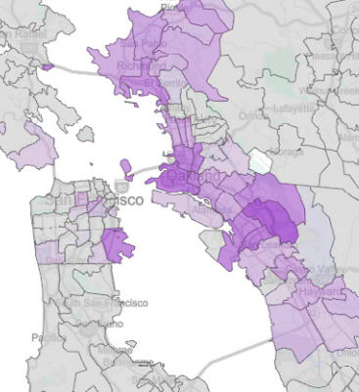
Racially Disparate Impact on Reentering People
Disparity in police stops/ ticketing
Funding courts with tickets encourages aggressive policing
Disparity in FTA/ FTP
Compounds disparity of criminal justice system generally
Notes:
2. Disparately impacts residents of color
-Racial disparity in ticketing and license suspension (Black people in SF make up 6% of population, but 70% of DL suspension, most of which are for FTA/FTP)
-Because people of color in SF have lower than average income, they are more likely to be unable to pay - compounds in racial inequality

Slide 28
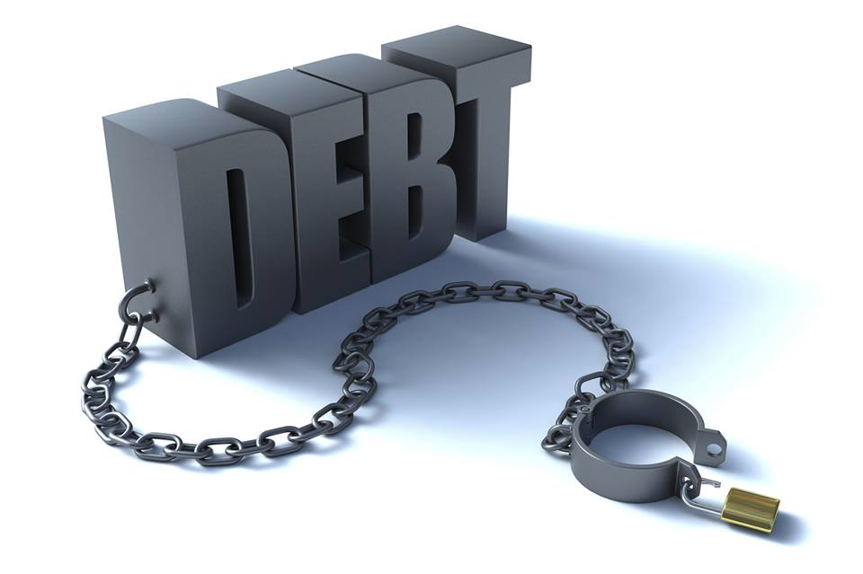
A Strategic Plan for Ending the Poverty Cycle of Court-Ordered Debt

Slide 29
1) Support & Expand the Traffic Amnesty Program
100% participation goal
Notes:
-Amnesty is a step in the right direction, but it must be a starting point, not an ending point. The great things about the program are:
It reduces the heavy burden of these fines for tickets below 2013, depending on income
It restores driver’s licenses
But, there are also major implementation challenges, and its impact is limited, including the fact that it will end in 2017.
SF can and should do more, both to support the existing program, and expand upon it.
- There is a backlog and the city can help by supporting administration of the program through the budget
- Provide funding to community-based organizations to do outreach and help people through the application process
Eliminate $50 participation fee, $55 DMV license reinstatement fee
- Establish a moratorium on license suspensions during Amnesty period
- Explore alternatives to payment for people who are low-income – for example dismissal of fines or non-monetary payment options like participation in training programs and community service

Slide 30
2) Eliminate License Suspensions as a debt collection tool
Stop the cycle of poverty
Notes:
Suspending someone’s license because of a failure to pay a fine takes away their livelihood, pushing them further into poverty and making it even more impossible to pay. People who have no other option than to drive then face the risk of a conviction for driving on a suspended license, fueling a cycle of debt, poverty, and incarceration.
Establish as local policy that license suspensions are an inappropriate collection tool for infraction-related debt
Direct all city agencies to cease reporting non-traffic violations to the DMV
This is also an action that the court could pursue as well, as suspended licenses for failing to appear or pay is a discretionary act.

Slide 31
3) Terminate Contracts with Private Debt Collectors
End relationship with AllianceOne
Notes:
-AllianceOne is a company from outside San Francisco that is profiting from the inability of low-income people to pay off enormous amounts of debt
-It has numerous agents who are never trained properly and give misinformation
Instead of this inefficient and unjust system, San Francisco could establish a local system for debt collection that embodies the principles of access and fairness.
-For example, an in-house program could allow for reductions of fines based on ability to pay, and payment plans that are manageable for people are all different income levels

Slide 32
4) Access to Courts for All
Low-income people no longer locked out
Notes:
People who miss a court date, no matter the reason, are locked out of scheduling a new court date. As a result, there is no meaningful opportunity to seek relief from past debt. Expanding on the amnesty program, and in the collaborative court model that the county has previously supported, San Francisco could establish a debt relief court to allow an efficient and just means for dealing with infractions and court-ordered debt.
Short of such a calendar, there are more incremental steps the court could take, including:
-Allowing people who failed to appear to schedule a court date or file a written request relief without first having to pay the full amount owed up front
There is also the issue of bench warrants issued for failing to appear in traffic court. Over the past two years, more than 10,000 people had been booked in SF’s jails for such warrants, a huge waste of resources and yet another way that we have criminalized poverty. We applaud the court’s action last fall to recall over 7,000 bench warrants that had been issued for failing to appear in traffic court. To the extent that arrests continue to occur since the recall, the city should direct all law enforcement agencies to end enforcement of traffic court bench warrants issued for a failure to appear or pay on an infraction.

Slide 33
5) Alternatives to Payment
Making the system work for our communities
Notes:
As an overarching matter, San Francisco must confront the question of how court-ordered debt is making our families and communities worse off – less safe, less productive, less self-sufficient, less stable. Everything should be on the table to reduce these harms, including:
- ending enforcement of so-called “quality of life” citations,
- dismissing warrants and fines for these types of tickets,
- for all other types of tickets, reducing the fine amounts for people who are low-income,
- and establishing meaningful alternatives to monetary payment.
A debt relief court would be one way to institutionalize these principles and ensure that the system works for our communities.
We could also pursue reforms to make the existing options more fair. For example, under the current system, community service is the only alternative offered, and is generally not available for anyone who misses their court date. A client of ours was required to complete 300 hours in 2 months and had a full-time job. To make this process more fair, San Francisco should seek to:
Eliminate the fee requirement for participation in Project 20
Increase the value of work credit hours; currently is below minimum wage
And include options for participation in social services and educational or job training program

Slide 34
Q & A
Elisa Della-Piana
Legal Director, Lawyers’ Committee for Civil Rights
Avni Desai
Public Policy Manager, Community Housing Partnership
Brittany Stonesifer
Staff Attorney, Legal Services for Prisoners with Children

